Slide 2
FUNCTIONAL PARAMETERS
Preemptivity,
Criticality,
Optional interval,
Laxity type.

Slide 3
Preemptivity of Jobs
Executions of jobs can often be interleaved. The scheduler may suspend the execution of a less urgent job and give the processor to a more urgent job. Later when the more urgent job completes, the scheduler returns the processor to the less urgent job so the job can resume execution. This interruption of job execution is called preemption.
A job is preemptable if its execution can be suspended at any time to allow the execution of other jobs and, later on, can be resumed from the point of suspension.

Slide 4
Nonpreemptable
A job is nonpreemptable if it must be executed from start to completion without interruption. This constraint may be imposed because its execution, if suspended and the processor given to other jobs, must be executed again from the beginning.
As an example, we consider
jobs that model the transmissions of data frames in a token ring (or bus). If transmission of a frame is interrupted before it completes, the partially transmitted frame is discarded by the receiver. The entire frame must be retransmitted from the start. To avoid wasting bandwidth in this way, we make the execution of this job on the ring (or bus) nonpreemptable.

Slide 5
Criticality of Jobs
In any system, jobs are not equally important. The importance (or criticality) of a job is a positive number that indicates how critical the job is with respect to other jobs; the more critical the job, the larger its importance. the terms priority and weight are often used to refer to importance; the more important a job, the higher its priority or the larger its weight.

Slide 6
Optional Executions
It is often possible to structure an application so that some jobs or portions of jobs are optional. If an optional job or an optional portion of a job completes late or is not executed at all, the system performance may degrade, but nevertheless function satisfactorily. In contrast, jobs and portions of jobs that are not optional are mandatory; they must be executed to completion.
Therefore, during a transient overload when it is not possible to complete all the jobs in time,we may choose to discard optional jobs (i.e, leave them unexecuted or partially executed) so that the mandatory jobs can complete in time

Slide 7
Laxity Type and Laxity Function
The laxity type of a job indicates whether its timing constraints are soft or hard. the laxity type of a job is sometimes supplemented by a usefulness function. This function gives the usefulness of the result produced by the job as a function of its tardiness.
functions are usually associated with hard real-time jobs. The usefulness of the result becomes zero or negative as soon as the job is tardy. In the latter case, it is better not to execute the job than to execute it and complete it late. In other words, it is “better never than late.” As mentioned the transmission and execution of a command to release a bomb on a target is an example of jobs with this laxity type.

Slide 8
Functional Parameters Summary
Jobs may have priority, and in some cases may be interrupted by
a higher priority job – A job is preemptable if its execution can be interrupted in this manner
A job is non-preemptable if it must run to completion once started
• Many preemptable jobs have periods during which they cannot be preempted;(while using critical section)
– The ability to preempt a job (or not) impacts the scheduling algorithm
– The context switch time is the time taken to switch between jobs and Forms an overhead that must be accounted for when scheduling jobs
– Some jobs have optional parts, that can be omitted to save time (at theexpense of a poorer quality result)
– Usefulness of late results varies; some applications tolerate some delay,others do not

Slide 9
RESOURCE PARAMETERS OF JOBS
Every job requires a processor throughout its execution. In addition to a processor, a job may also require some resources.
The resource parameters of each job give us the type of processor and the units of each resource type required by the job and the time intervals during its execution when the units are required. These parameters provide the information that is needed to support resource management decisions.

Slide 10
A resource is nonpreemptable if each unit of the resource is constrained to be used serially. once a unit of a nonpreemptable resource is allocated to a job, other jobs needing the unit must wait until the job completes it.
Otherwise, if jobs can use every unit of a resource in an interleaved fashion, the resource is preemptable. The lock on a data object in a database is an example of nonpreemptable resource.

Slide 11
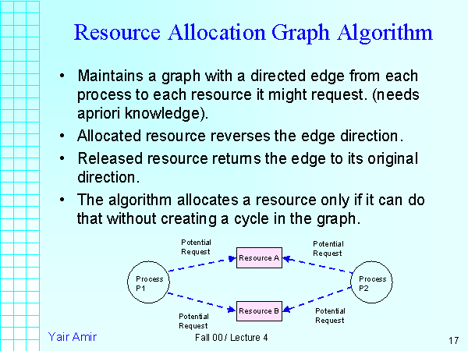

Slide 12
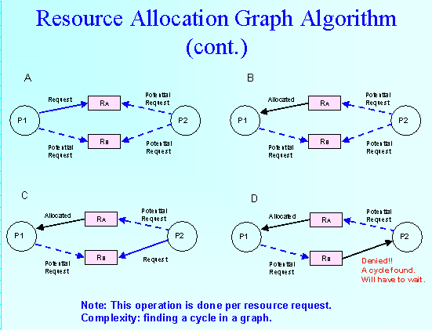

Slide 13
Resource Graph
In a resource graph, there is a vertex Ri for every processor or resource Ri in the system. The attributes of the vertex are the parameters of the resource. In particular, the resource type of a resource tells us whether the resource is a processor or a (passive) resource, and its number gives us the number of available units.
While edges in task graphs represent different types of dependencies among jobs, edges in a resource graph represent the relationship among resources.
Using different types of edges, we can describe different configurations of the underlying system. There are two types of edges in resource graphs. An edge from a vertex Ri to another vertex Rk can mean that Rk is a component of Ri .
(For example, a memory is part of a computer, and so is a monitor.) This edge is an is-a-part-of edge. Clearly, the subgraph containing all the is-a-part-of edges is a forest.
The root of each tree represents a major component which contains subcomponents represented by vertices in the tree. As an example, the resource graph in a system containing two computers consists of two trees. The root of each tree represents a computer. The children of this vertex include one or more CPUs, main memory, and so on. Each of these subcomponents is represented by a vertex, and there is an edge from the computer vertex to each subcomponent vertex.

Slide 14
Scheduler and Schedules
Jobs are scheduled and allocated resources according to a chosen set of scheduling algorithms and resource access-control protocols. The module which implements these algorithms is called the scheduler.

Slide 15
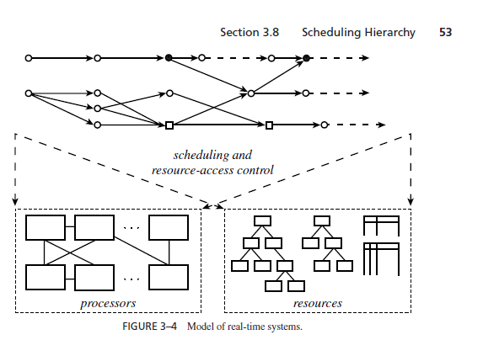
Scheduling Hierarchy

Slide 16
SCHEDULING HIERARCHY
Figure shows the three elements of our model of real-time systems together. The application system is represented by a task graph, exemplified by the graph on the top of the diagram. This graph gives the processor time and resource requirements of jobs, the timing constraints of each job, and the dependencies of jobs.
The resource graph describes the amounts of the resources available to execute the application system, the attributes of the resources, and the rules governing their usage.
Between them are the scheduling and resource access-control algorithms used by the operating system.

Slide 17
A valid schedule satisfies the following conditions:
– Every processor is assigned to at most one job at any time
– Every job is assigned at most one processor at any time
– No job is scheduled before its release time
– The total amount of processor time assigned to every job is equal to its maximum or actual execution time
– All the precedence and resource usage constraints are satisfied

Slide 18
Feasibility, Optimality, and Performance Measures
A valid schedule is a feasible schedule if every job completes by its deadline (or, in general,meets its timing constraints).We say that a set of jobs is schedulable according to a scheduling algorithm if when using the algorithm the scheduler always produces a feasible schedule.

Slide 19
In addition to the criterion based on feasibility, other commonly used performance measures include the maximum and average tardiness, lateness, and response time and the miss, loss, and invalid rates.
The lateness of a job is the difference between its completion time and its deadline. Unlike the tardiness of a job which never has negative values, the lateness of a job which completes early is negative, while the lateness of a job which completes late is positive. Sometimes,
we want to keep jitters in the completion times small; we can do so by using scheduling algorithms that try to minimize the average absolute lateness of jobs.

Slide 20
A valid schedule is also a feasible schedule if every job meets its timing constraints.
– Miss rate is the percentage of jobs that are executed but completed too late
– Loss rate is the percentage of jobs that are not executed at all
A hard real time scheduling algorithm is optimal if the algorithm always produces a feasible schedule if the given set of jobs has feasible schedules

Slide 21
Summary
• Outline of terminology and a reference model:
– Jobs and tasks
– Processors and resources
– Time and timing constraints
• Hard real-time
• Soft real-time
– Periodic, aperiodic and sporadic tasks
– Precedence constraints and dependencies
– Scheduling

